Slide 1


Software Development Process
You need a better one

Slide 2
Introduction
Also known as Development Methodology or Software Development Life Cycle (SDLC)
Divide software development into manageable steps (subprocesses) that can be:
Sequential
Parallel
Cyclical
Every coder has implemented an SDLC, at the very least you have used…

Slide 3


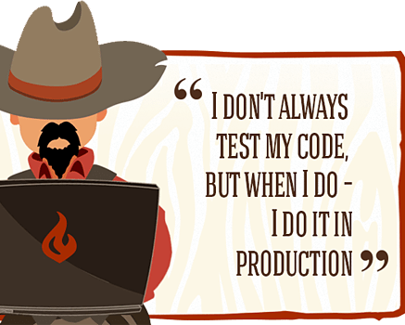
Cowboy coding
Start coding with no plan
Minimal care for requirements
Your code is final, no prototyping
The software is developed as you type
Only test is if it will compile and run
It is all deployed or comes down burning
Maintaining a code is a nightmare and often requires building the whole thing again

Slide 4







The Seven Phases of an SDLC
PLANNING
DEFINING REQUIREMENTS
DESIGN AND PROTOTYPING
SOFTWARE DEVELOPMENT
TESTING
DEPLOYMENT
OPERATIONS AND MAINTENEANCE

Slide 5
Waterfall Method
Requirements
One of the oldest SDLCs
Complete each step before moving on to the next, rarely revisiting previous stages
Documentation driven, specifications should be created before any development
Good for large and critical applications, especially safety or compliance driving systems
Design
Development
Testing
Maintenance

Slide 6
Waterfall Pros & Cons
√ Software process subject to discipline, planning, and management
√ Postpone implementation to after understanding objectives
√ Time spent upfront can save time later during development
x No feedback between steps, and steps are rarely revisited
x No development parallelism, lock-step development between steps
x Single monolithic delivery date, integrations often happens near the end
x No changes anticipated, build everything correctly the first time
x Important stages (testing) reserved to the end when time is tightest

Slide 7

Waterfall Use Cases
Safety Critical Systems: Systems where there can be grave consequences if the software does not always operate properly.
Legally Mandated Systems: Systems where a large part of their requirements are specified by a law, required specifications, or government agency.
Contracted Systems: Systems where the specifications of the project and their completion are defined in the contract.

Slide 8


Agile
Set of principles/values for software development (and other things)
Individuals and interactions over processes and tools
Working software over comprehensive documentation
Customer collaboration over contract negotiation
Responding to change over following a plan

Slide 9
Agile methods
Agile modeling
Agile Unified Process
Extreme Programming
Kanban
Lean software development
Rapid application Development
Scrum
And many others…

Slide 10
Kanban (Signboard)
Lean/Just-in-time manufacturing method developed by Taiichi Ohno at Toyota
“Limiting the number of pending requests makes the process more sensitive and reveals inefficiencies.”
This process focuses on creating bins/columns/stages that represent the pipeline a task needs to advance through to be completed
The number of tasks that can exist in each part of the pipeline is then limited to increase throughput (Work In Progress limit or WIP limit)
This is usually illustrated through tasks represented as cards, which are moved along different columns on a board to represent their position in the pipeline

Slide 11

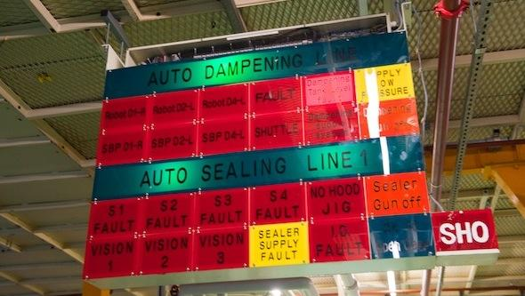

Slide 12
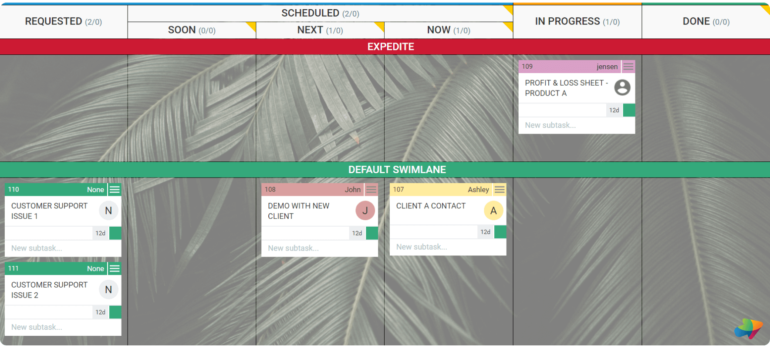

Slide 13
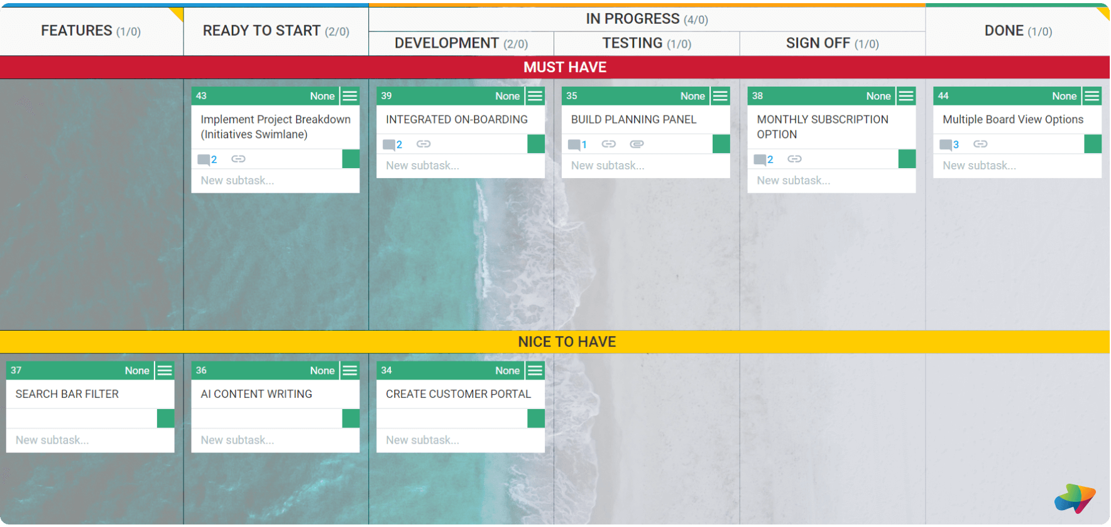

Slide 14
Pros
Tasks are not prescribed a certain size or deadline, and can all travel through the system independently
Works well for both individuals and small teams, with specialized and generalized contributors
Allows for large variety in the types of tasks which can exist on the board

Slide 15
Cons
Lack of timeframes or priorities is not always realistic (priority and lanes were developed to help solve these issues)
Process can become chaotic with larger teams, where having a lead can be beneficial

Slide 16
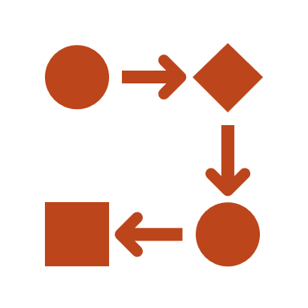


Kanban Use Cases
Individual Development/Organization
Small Group Development
Organization between Distinct Groups
Create a Kanban board for your individual development projects or even for normal activities.
Keeps you focused and stops you from jumping between many tasks without major progress
When working with a small group of developers who all have equal ownership of a project
The first column becomes a global task queue
When working with distinct groups within an organization that have well defined ownerships of different development stages
Identify and address bottlenecks
Stop groups from being overwhelmed

Slide 17
Kanban Board Activity
Go to any of your repositories on GitHub and start a Kanban board project with Backlog, TODO, In Development, In Testing and Done columns.

Slide 18


Scrum
Lightweight agile process for small, cross-functional, self organized teams
Has a small number of roles to keep members focused and make sure neither business or engineering overtake the development conversation

Slide 19
Scrum Roles
Scrum Master
Scrum Team
Product Owner
Typically filled by project manager or team lead
Removes impediments from scrum team members
Enforces scrum principles
Typically, 5-10 cross functional members
Members are full time
Members can only change teams between sprints
Acts like a single voice for the “user”
Knows what features (not development tasks) need to be build and in what sequence
Typically, a product manager

Slide 20





Sprint Cycle
Product Owners create a product backlog of features that need to be developed, and prioritize that backlog based on current needs
The highest priority tasks are broken down into small deliverable tasks, which are then prioritized by developers and estimated for time
Tasks are assigned to members that can be completed in the next sprint, a short period of time where development goals are fixed and cannot be changed (usually 2 weeks)
Information and issues are shared between team members through **daily stand-up meetings**
After each sprint, goals and progress are re-assessed and re-prioritized and a new sprint is planned

Slide 21








Sprint Planning Example
Sprint Cycle: 2 weeks
Total work hours per day: 8 hours/day
Other work hours per day: 2 hours/day
Actual work hours per day: 8 - 2 = 6 hours/day
6 hours/day * 5 days/week * 2 weeks = 60 hours/sprint
Each team member can support 60 hours worth of work in a sprint
There are lots of other ways to do these types of estimates, but hours is common
Scrum Team Size: 5 members
5 members * 60 hours/sprint = 300 hours/sprint total team effort
Not every member will have the same “other work” hours, so this is usually a sum not multiple

Slide 22

Daily Scrums

Slide 23
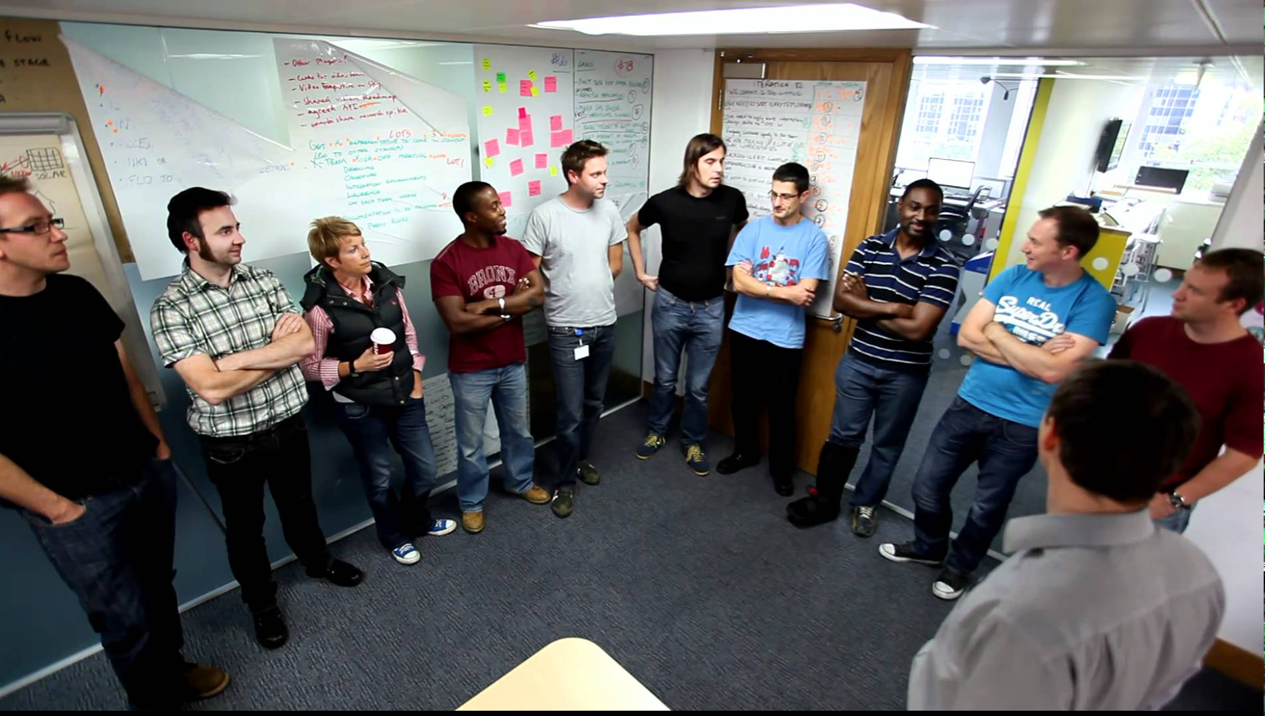
Typical Standup Meeting (5-10 min)

Slide 24

(New) Typical Standup Meeting

Slide 25
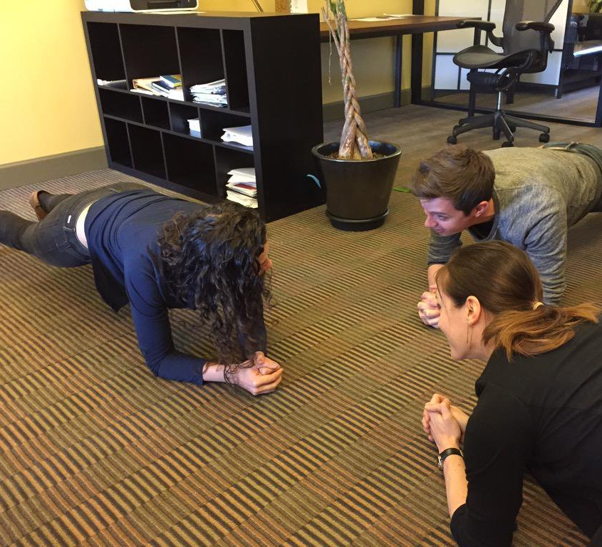
Planking Standup Meeting (1-2 min)

Slide 26
Scrum Pros & Cons
Provides balance between developer interests and business interests
Provides dedicated roles, allowing team members to concentrate on developing
Allows business priorities to shift without creating a moving development target
Creates organizational overhead (sprint planning meetings, standup meetings, review meetings, user story meetings, etc.)
Allows for feature creep since there is no defined end-date or final product
Losing team members can create large negative impacts on the team/project

Slide 27
Do you even Scrum?
Full
Medium
Light
Dedicated members with roles and dedicated meeting times
Disconnect between product owner and scrum team, manager de-facto scrum master
Daily standup meetings

Slide 28


So, you want to be a Scrum Master?
Scrum Guide: https://scrumguides.org/
A Scrum Book: The Spirit of the Game : http://scrumbook.org/

Slide 29

Scrum Patterns (From A Scrum Book)
These are solutions to specific problems that may arise in the development process. Some popular patterns are:
Daily Scrum
Emergency Procedure
Definition of Ready
Pop the Happy Bubble
Scrum of Scrums
Sprint Review
And many more…

Slide 30

Questions?

